Slide 1
LOCAL SEARCH ALGORITHMS AND OPTIMIZATION PROBLEMS

Slide 2
Introduction
In many problems, however, the path to the goal is irrelevant. For example, in the 8-queens problem, what matters is the final configuration of queens, not the order in which they are added.
Local search algorithms operate using a single current node (rather than multiple paths) and generally move only to neighbors of that node.
Paths followed by the search are not retained (cannot backtrack).
Two key advantages:
they use very little memory
they can often find reasonable solutions in large or infinite (continuous) state spaces.

Slide 3
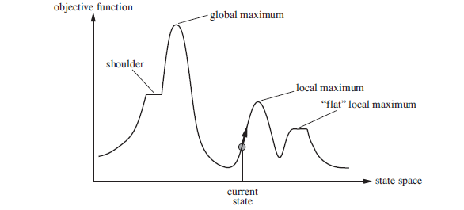
In addition to finding goals, local search algorithms are useful for solving pure optimization problems, in which the aim is to find the best state according to an objective function.

Slide 4
If objective function corresponds to cost, then, find the lowest valley—a global minimum; if objective function aims to maximize the value, then find the highest peak—a global maximum.
A complete local search algorithm always finds a goal if one exists; an optimal algorithm always finds a global minimum/maximum.

Slide 5
1- Hill-climbing search
Hill Climbing is a heuristic search used for mathematical optimization problems.
It is simply a loop that continually moves in the direction of increasing value—that is, uphill. It terminates when it reaches a “peak” where no neighbor has a higher value.
Hill climbing is sometimes called greedy local search because it grabs a good neighbor state without thinking ahead about where to go next.
1. Generate possible solutions. 2. Test to see if this is the expected solution. 3. If the solution has been found quit else go to step 1.

Slide 6
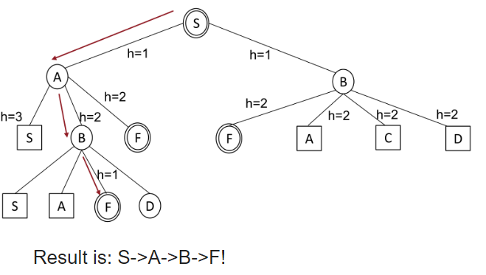
Greedy local search algorithm/hill climbing

Slide 7
Three well-known drawbacks:
Local maxima: Hill-climbing algorithms that reach the vicinity of a local maximum will be drawn upward toward the peak but will then be stuck with nowhere else to go.
Plateaux/flat : a plateau is an area of the state space where the evaluation function is essentially flat. It can be a flat local maximum, from which no uphill exit exists, or a shoulder, from which progress is possible
Ridges: Ridges result in a sequence of local maxima that is very difficult for greedy algorithms to navigate.

Slide 8
Variants of hill climbing
Stochastic hill climbing
First-choice hill climbing
Random-restart hill climbing

Slide 9
2- Simulated annealing
A hill-climbing algorithm that never makes “downhill” moves toward states with lower value (or higher cost) is guaranteed to be incomplete, because it can get stuck on a local maximum.
In contrast, a purely random walk algorithm—that is, moving to a successor chosen uniformly at random from the set of successors—is complete but extremely inefficient.
Therefore, it seems reasonable to try to combine hill climbing with a random walk in some way that yields both efficiency and completeness.

Slide 10
Instead of starting again randomly when stuck on a local maximum, we could allow the search to take some downhill steps to escape the local maximum.
The inner working of simulated annealing is quite similar to hill climbing. Instead of picking the best move, however, it picks a random move.
If the move actually improves the situation, it is always executed. Otherwise, the algorithm makes the move with some probability less than 1.

Slide 11
Local beam search
Keeping just one node in memory might seem to be an extreme reaction to the problem of memory limitations. The local beam search algorithm keeps track of k states rather than just one.
It begins with k randomly generated states.
At each step, all the successors of all k states are generated. If any one is a goal, the algorithm halts.
Otherwise, it selects the k best successors from the complete list and repeats.
A local beam search with k states might seem to be nothing more than running k random restarts in parallel instead of in sequence.

Slide 12
In fact, the two algorithms are quite different. In a random-restart search, each search process runs independently of the others.
In local beam search, useful information is passed among the parallel search threads. The states that generate the best successors say to the others to come closer
Local beam search can suffer from a lack of diversity among the k states—they can quickly become concentrated in a small region of the state space, making the search little more than an expensive version of hill climbing.
A variant called stochastic beam search, helps alleviate the problem of diversity.

